Slide 1
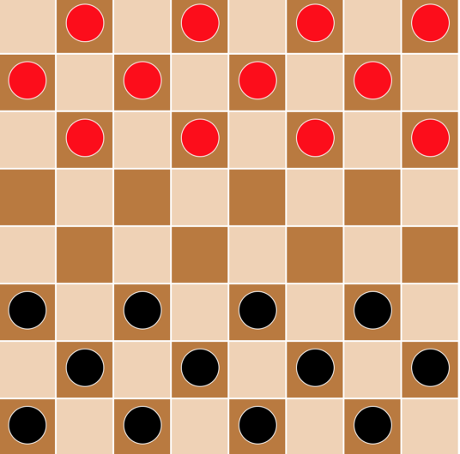
Course Project
Group 12: Esmeralda Xhyliu, Tytionna Williams, Connor Van Etten

Slide 2
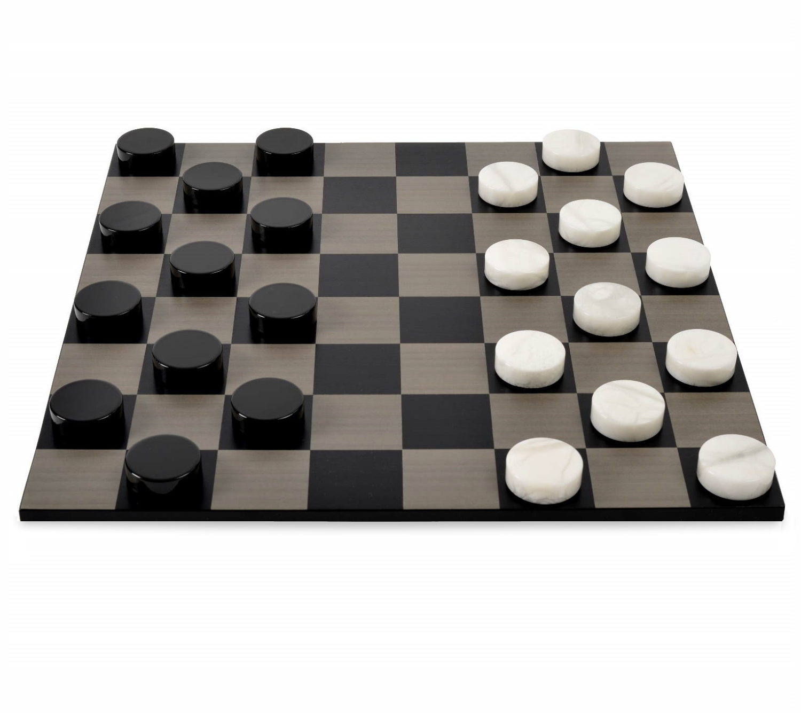
Abstract
Implementing the game of checkers into an easily playable and customizable Graphical User Interface (GUI) is the purpose our group 12’s term project. Checkers is a classic boardgame that is played by two players accompanying 12 pieces each. While the game has basic rules such as jump to take a piece and diagonal movement only careful planning and efficient algorithms are set into place to make it work smoothly for the user. Intertwining both software engineering models and productive group work practices, we will aim to build a fully functional GUI of checkers with multiple mode. This will include a PvP, PvE, and a CPUvCPU mode.

Slide 3
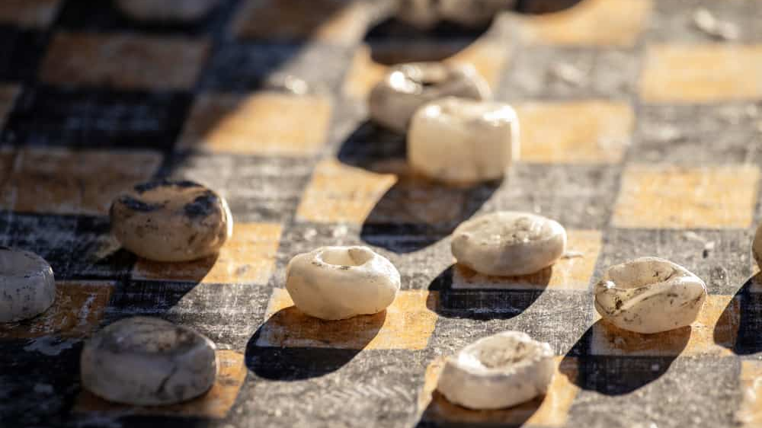
Background
Checkers is a game that is believed to have existed since 3,000 B.C.E., in an ancient city called Ur in Iraq.
However, the earliest known version of the game comes from a game called Alquerque, which was played in ancient Egypt in 1400 BC.
Nowadays, the game of Checkers today is played competitively as well as just for entertainment. Other than being fun, the game develops brain power, logical thinking, confidence, strategy, as well as provides cognitive development.

Slide 4
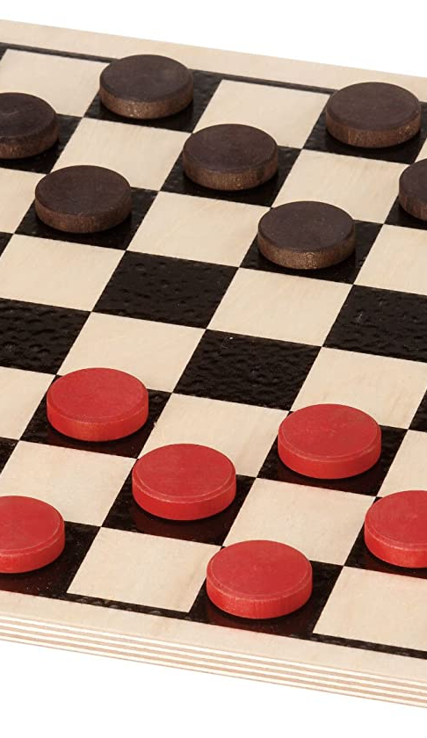
Introduction
Our project is intended to entertain players, it is not a new work in the game field. The game, traditionally played on an 8x8 board has had many variations over the years, however, its main theme has not changed.
There are two objectives when playing checkers. The main objective is to capture as many of the opponent’s pieces as possible until the opponent has no more potential moves.
The other objective is to get to the opponent’s side of the board in order to crown their pieces king along the way.

Slide 5
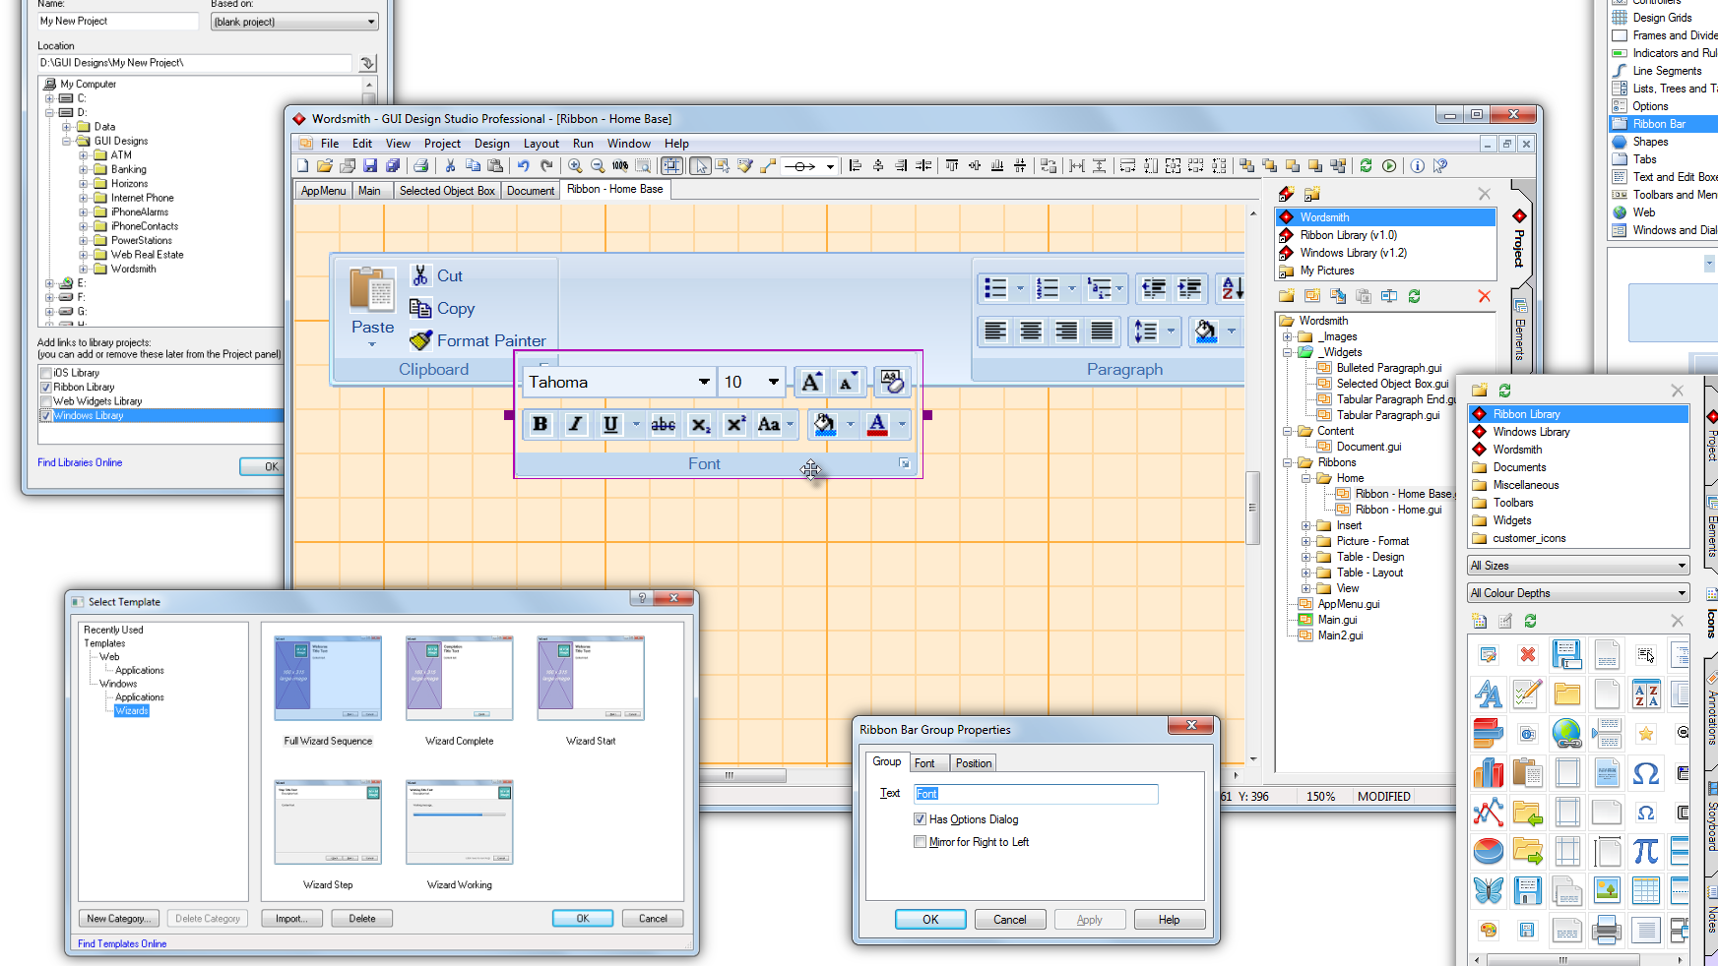
Project Objectives
The goal is to make the GUI version of the game as like the physical board game as possible
Two options for play style
Player verses player
Player versus computer
User-friendly interface
Reflect the game of Checkers
Board shape, colors and pieces
Competitive computer movements

Slide 6

Methodology – Design Specifications
Main Menu will contain:
3 options to either begin the game versus a person, versus the computer (AI) or to exit the game.
Both modes will share the same game rules but will play slightly different
Single Player mode, user will always start regardless of color (randomized)
Two Player mode, user who is assigned black will start
Special Features to be added to our Implementation
Move availability highlighting
Graphically seeing the pieces move (Hopefully a Drag and Drop)
Visualizing the Score to the right of and left of the board.
Visual Indication of turn

Slide 7
Methodology – Design Specifications - Continued
Languages
HTML, JavaScript, CSS
Designing the AI
Identify the position of each piece on the board
Identify the team of the pieces (Using Arrays)
Series of If-Else statements to determine
Open squares on the board
Jump available

Slide 8
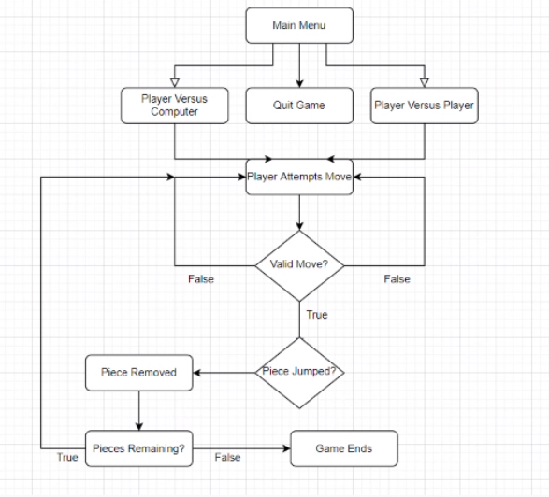
Methodology – System Architecture
Visual Depiction of our Game Flow

Slide 9
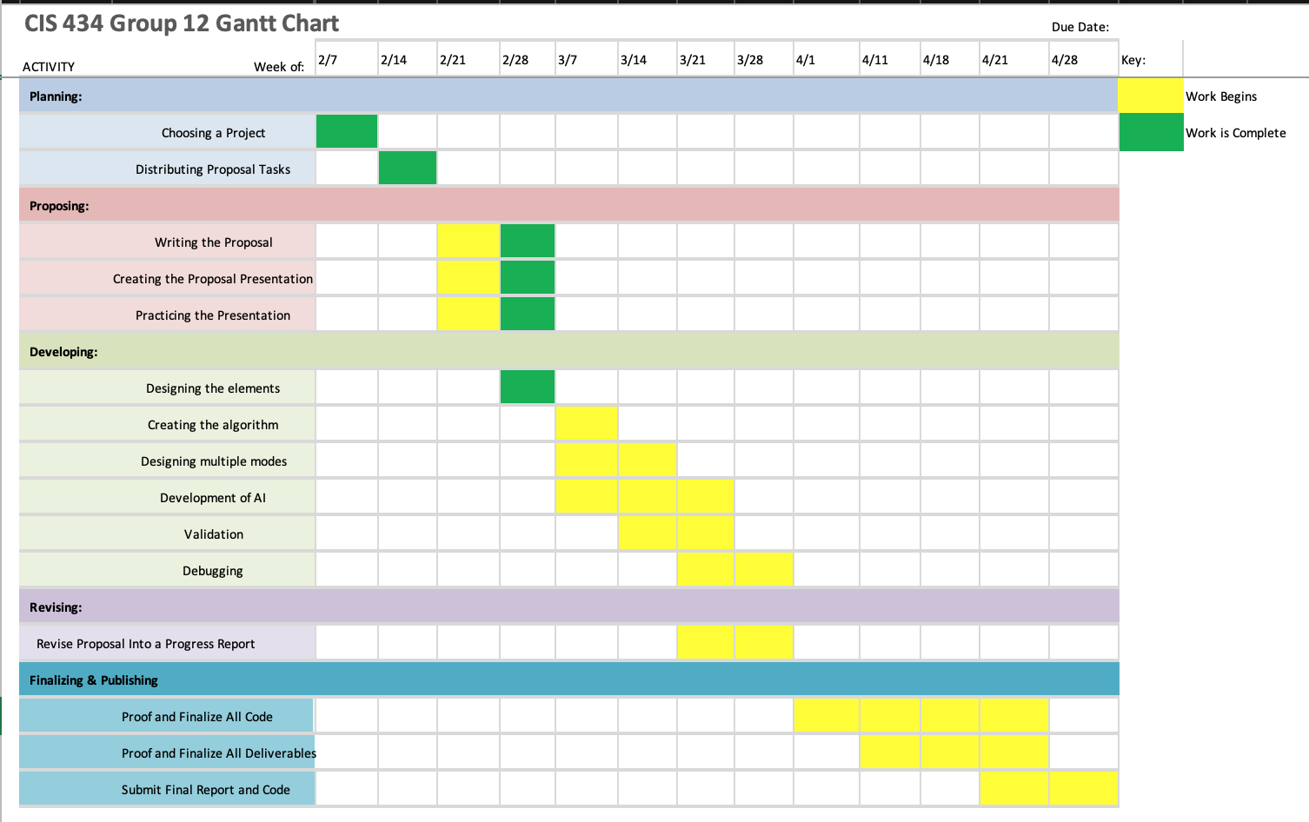
Timeline
Gantt Design Process
This includes a weekly view of when work will be started and completed for each stage of the project.
This shows a visualized section of our Water Fall Model

Slide 10
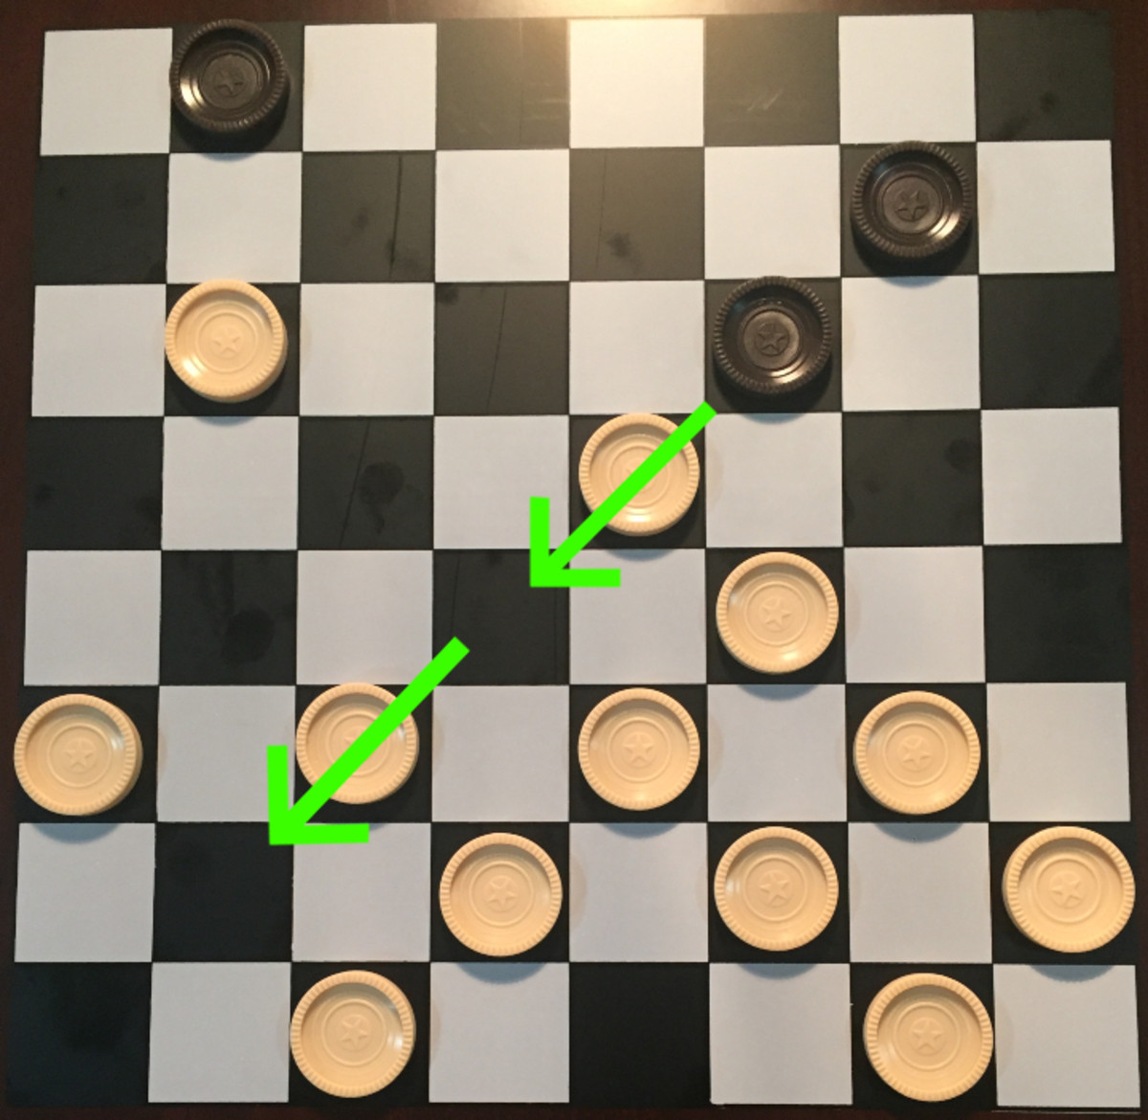
Conclusion
Using the Water-Fall structure to build help guide our development process we will use the languages HTML, CSS, and JavaScript to build a GUI that allows a user to play chess either against another user, the CPU or watch AI play each other. The board and elements of the game will be built using HTML and CSS to make changes both easy to change and implement. The play and logic of the game will be implemented using an array that is built within JavaScript and several functions to check the validation of moves and scores. When all is completed, we will have 3 main modes of play and fully functional GUI.

